Slide 1


Data Bootcamp Final Project Presentation The impact of COVID 19 on students Education and Mental Health
By Adele Khankai

Slide 2

About Me
I am a mother of 3, dedicated to achieve my goals and show my children the meaning of enjoying life.
I studied Children and young people's workforce however did not go into further education.
I have come from a managing/coordinating background, where I focused on ensuring business structure was followed and upheld. Whilst also managing the student journey and experience at BCU.

Slide 3






How did you apply what you have learnt in the Bootcamp?
I planned my project to ensure I met all the requirements of the assignment brief. I included:
Data analysis using EXCEL
Data analysis using SQL
Data Visualisation using PowerBI
I also completed my presentation in line with these target deadlines.

Slide 4


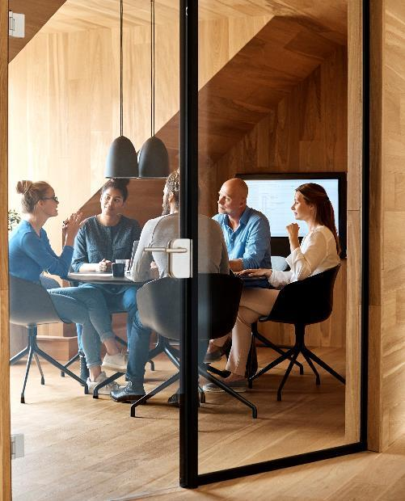

Why did I choose to learn Data Analysis?
I took the opportunity to develop myself with Niyo Enterprise as I came from a background of having very little education. I thought this would be an interesting way to gain an understanding of business insight and improvement.
What role would I like to be in?
Data Analyst
Data Scientist
Business Analyst

Slide 5

About My Project
My Objective within this project is to investigate what correlation we see with the changes in delivered education and the behavior of students. I also want to explore how students react to education without a social environment.

Slide 6
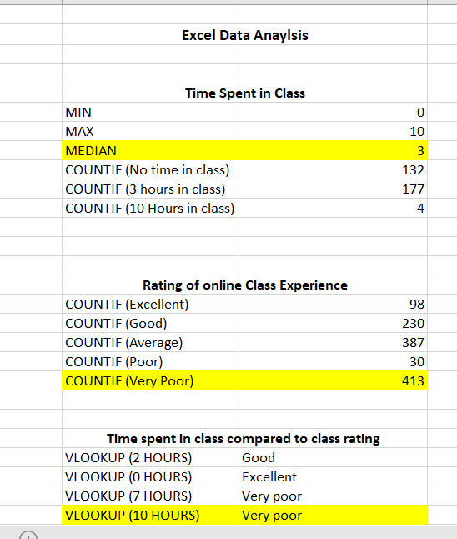
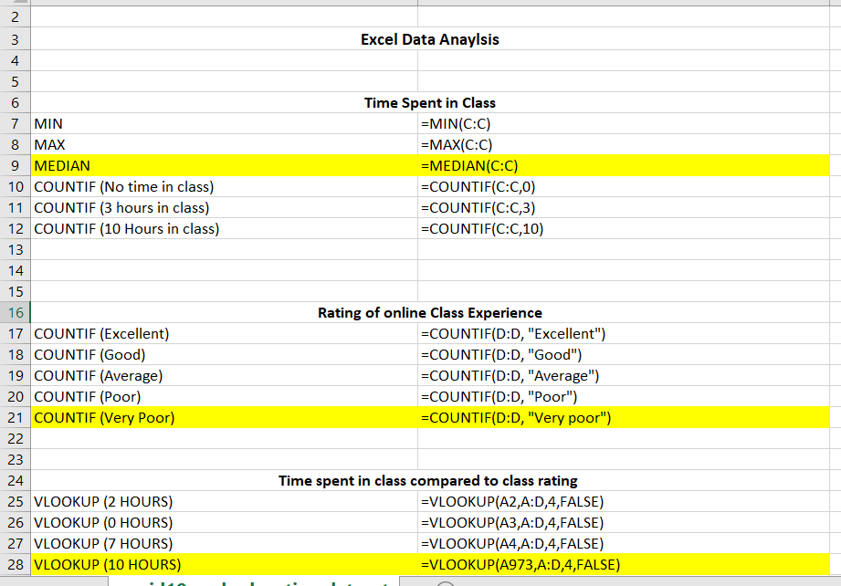
Excel Analysis
Through my Excel Analysis I found that the students who attended class did not rate the class very highly. Out of the normal learning week student's maximum attendance was 10 hours. Which is approximately only 2 days of their normal learning schedule.
The students were not subject to their normal efforts or discipline to keep them engaged in their lessons. They indulged in social media which in turn could create a generation that rely on a false reality.
With the social aspect of education being removed I have concluded that many of the students turned to Social media and music to destress themselves and fulfil their need to be around people

Slide 7
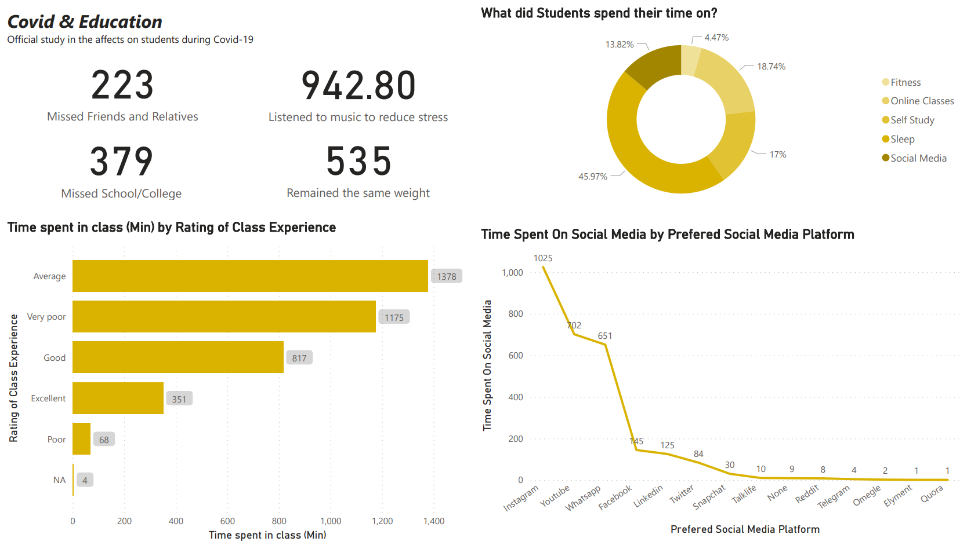
Table

Slide 8

Summary
Educationally- Sometimes it may take me longer to catch on to things but that’s ok because eventually I will get it and be good at it.
Personally- I’m stronger than I think, I wasn’t sure how if I would be able to do everything needed in my life before and complete a course
Career Wise- I have found something I really enjoy and with hard work and practise will be really good at

Slide 9


Thank You
Adele Khankai

